Slide 1
Alcohol Deregulation Efforts: COVID and Beyond
Dylan Ellerbee, U.S.APA

Slide 2
Overview
The US Alcohol Policy Alliance
Current Landscape: Deregulation
Alcohol Advertising During COVID-19
Public Health and Environmental Strategies
The 4 P’s
Taking Action

Slide 3
The US Alcohol Policy Alliance
Organized in 2011, 501c(3) in 2015
Nonprofit, nonpartisan organization translating alcohol policy research into public health practice.
The Alliance is committed to ensuring that local and statewide organizations engaging in alcohol policy initiatives have access to the science, resources and technical assistance, including support for organizing efforts, required to engage in informed decisions and actions in translating alcohol policy research into public health practice.

Slide 4
Board
Nicole Holt, Chair (Texas)
Alicia Sparks, Vice Chair (California)
Dylan Ellerbee, Treasurer (North Carolina)
Mike Tobias, Secretary (Michigan)
Guy Williams (Michigan)
Tiffany Hall (Alaska)
Mike Marshall (Oregon)
Rick Collins (Hawaii)
Michelle Merritt (New Hampshire)

Slide 5
Advisory Board
Michael Sparks, MS - Co-chair - SparksInitiatives
Traci Toomey, PhD - Co-chair - University of Minnesota School of Public Health
Bill Kerr, PhD - Alcohol Research Group
Ryan Treffers, JD - Treffers Research
Rebecca Reynolds, MPH - Public Health Consultant
Michael Eisen, MA, LPC - North Carolina Department of Health and Human Services
Kelli Komro, PhD - Rollins School of Public Health
Jim Mosher, JD - Alcohol Policy Consultations (retired)
David Jernigan, PhD - Boston University School of Public Health
Elyse Grossman, PhD, JD - Johns Hopkins Bloomberg School of Public Health and The CDM Group, Inc.
Thomas Babor, PhD - University of Connecticut

Slide 6
Member/Board Member States
Texas, North Carolina, Michigan, California, Oregon, Hawaii, Alaska, New Hampshire, Nebraska

Slide 7
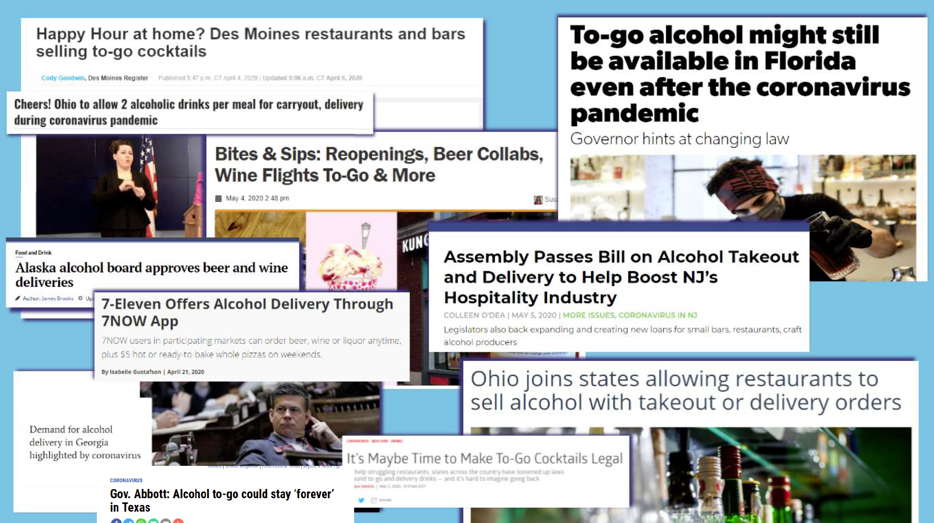
Current Landscape

Slide 8
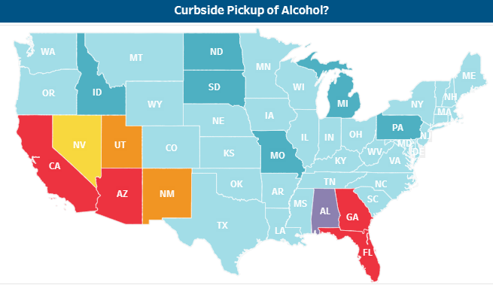
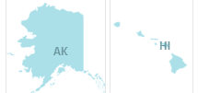
Curbside Pickup
Restaurants
Prior to COVID: 6 States
Since COVID (Mar/Apr): 48 States
1 state varies by locality
Bars
Prior to COVID: 6 States
Since COVID (Mar/Apr): 44 States
1 state varies by locality
https://www.nabca.org/covid-19-resources
Notes:
Image is curbside pickup in bars

Slide 9
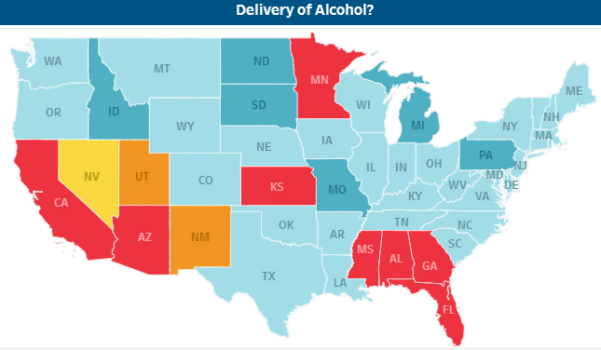
Alcohol Delivery
Restaurants
Prior to COVID: 6 states
Since COVID (Mar/Apr): 45 states
1 state varies by locality
Bars
Prior to COVID: 6 states
Since COVID (Mar/Apr): 40 states
1 state varies by locality
https://www.nabca.org/covid-19-resources
Notes:
Image is of alcohol delivery

Slide 10
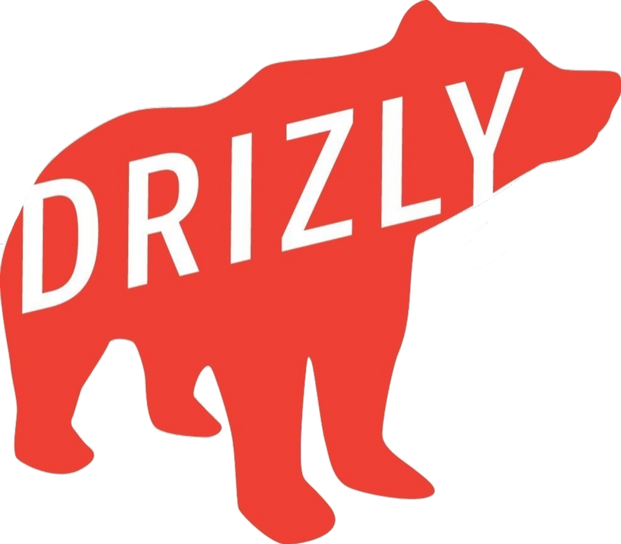
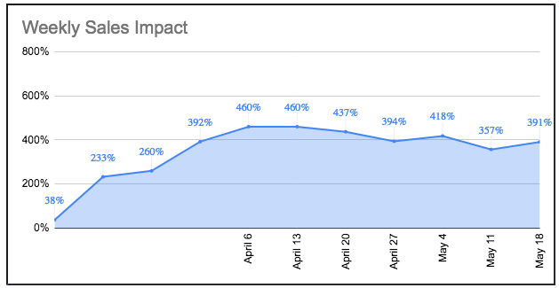
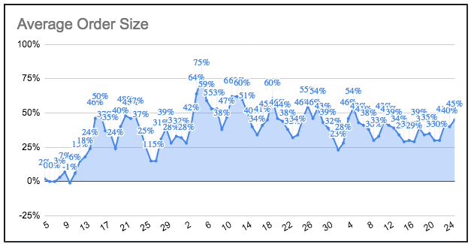
Alcohol Delivery
  Describes itself as the #1 alcohol delivery app
  Partners with 2,500+ retailers across North America in door-to-door delivery of beer, wine and distilled spirits
  As of May 18, sales were up by 357% over what they would expect to see during this time
  Customers are ordering more frequently, and with larger quantities – on average 50% more than previously
DRIZLY AND COVID
TA&D | Project Overview | 2020
Source: David Jernigan, PhD

Slide 11
Home Delivery
Restaurant/Bar Delivery
  States and localities allow restaurants or bars to deliver alcohol, most as a result of COVID-19.
Direct Shipment
  6 states allow shipment of beer, wine, and liquor
  8 states allow shipment of beer or wine
  35 states allow shipment of wine
How temporary is temporary?

Slide 12
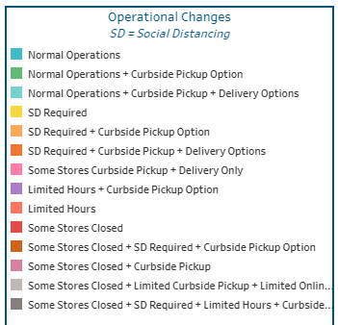
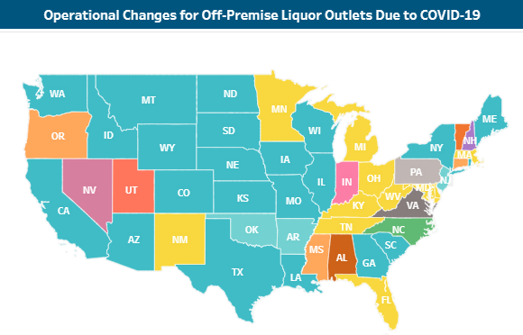
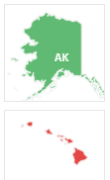
Off-Premise Operations
Allows curbside pickup and/or delivery

Slide 13
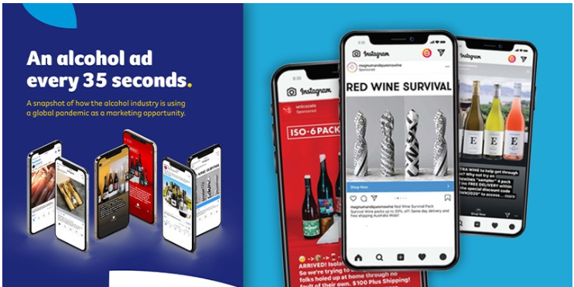
Alcohol Advertising During COVID-19: FARE Report
Notes:
More than 100 ads in an hour. Foundation for Alcohol Research and Education

Slide 14
Ads
Heineken: https://youtu.be/mo8COTSHCGc
Bacardi: https://youtu.be/mvia8xCdkXU

Slide 15
Bulleit Frontier Fund
Bulleit Frontier Fund: https://youtu.be/_mhTCaT1k40
At Bulleit, we are on a mission to support pioneers and communities pushing the frontier forward and shaping the world of tomorrow. As such, we have created The Bulleit Frontier Fund, and are announcing the launch of the fund with an initial donation of $250,000 to support the North American hospitality industry.
As a start, the Bulleit Frontier Fund will make donations to organizations such as the United States Bartenders Guild, Another Round, Another Rally and Southern Smoke

Slide 16
Digital Advertising

Slide 17
Alcohol Advertising During COVID-19
Messaging
get easy access to alcohol without leaving your home (58%)
save money (55%)
buy more (35%)
drink alcohol during the COVID-19 pandemic (24%)
use alcohol to cope, ‘survive’, or feel better (16%)
and choose ‘healthier’ alcohol products (14%)

Slide 18
Alcohol Advertising During COVID-19
Nearly three-quarters of advertisements (71%) explicitly or implicitly referenced the COVID-19 pandemic.
Two-thirds (66%) of the alcohol advertisements had a ‘Shop now’ or ‘Get offer’ button linking directly to their online store.
The marketing messages being used to promote alcohol during COVID-19 are particularly concerning as they promote known risk factors for harmful drinking, including buying more, drinking to cope, drinking daily and drinking at home or alone in the home.

Slide 19
Public Health Implications
Increase in alcohol consumption
Initial signs of increase in intimate partner violence due to more drinking at home
  18 of 22 police departments surveyed by NBC News reported an increase in domestic violence calls in March
Confinement, unemployment, economic instability and alcohol consumption increase risk of child abuse
Increased consumption means likely increase in all alcohol harms, including FASD

Slide 20
Public Health Model
Who is familiar?
  Very,
  somewhat,
  a little,
  not at all
Whose organizational members are familiar?
  Very,
  somewhat,
  a little,
  not at all

Slide 21
Public Health Model
Host (Individual)
Agent Environment
(AOD) (Locations, Settings,
Normative Culture)
Problems develop from the interaction of 3 things

Slide 22
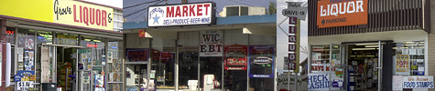
What the Science Says
Increased alcohol availability
Increased alcohol consumption
Increased public health/safety problems
Source: National Academy of Sciences

Slide 23
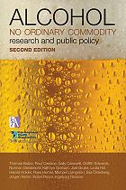
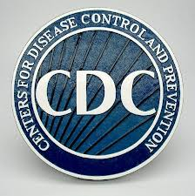
What works: Reviews of the U.S. Research Literature

Slide 24
Environmental Approaches
Build on and support traditional prevention efforts with a consistent message
But environmental change theory involves a fundamental shift in perspective…

Slide 25
Individually Focused Prevention Strategies Assume That AOD Problems Are Due To
Problems of individuals
Lack of information about alcohol
Lack of knowledge about negative consequences
Lack of awareness of “social norms”
Inadequate skills and abilities

Slide 26
The Environmental Approach
Targets the social, physical or public environment where sales/use occurs
Views alcohol and other drug problems not just as individual addiction, but rather as the collective reflection of community norms and practices
Targets are policy makers and others with authority to change environments
Seeks to change physical, legal, economic & social processes of communities

Slide 27
Frieden Pyramid in Action: Alcohol
Alcohol education and counseling, SBIRT
Evidence-based treatment and other medical interventions
Reduce poverty
Increase education and employment opportunities
Improve human rights
Population-level access to treatment and SBIRT, strong media campaigns
Remove dangerous products, e.g. AEDs; increase alcohol excise taxes; reduce alcohol outlets; restrict and reduce alcohol marketing
Smallest
Impact
Little political will needed
Largest
Impact
Much political will needed

Slide 28
Environmental Prevention
The “Four P’s”
PRODUCT
PROMOTION
PRICE
PLACE
Community Risk Factors
Which of these risk factors exist on your campus or in your surrounding community?

Slide 29
PRODUCT
Notes:
Here is our first “P”.

Slide 30
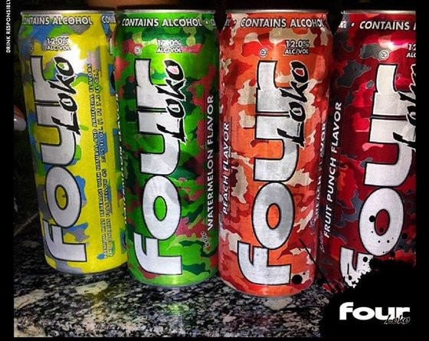
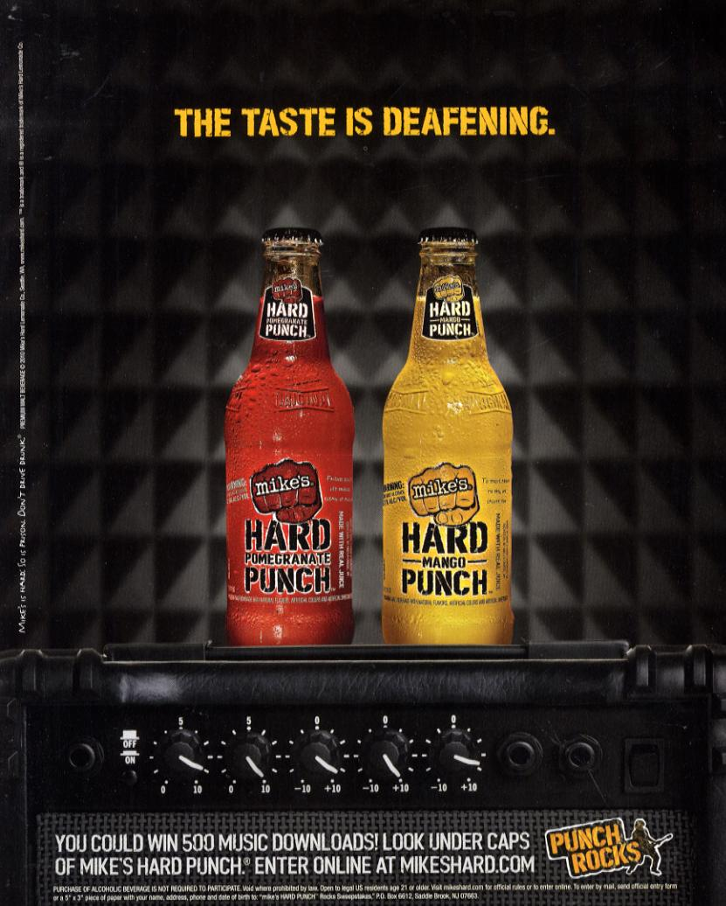
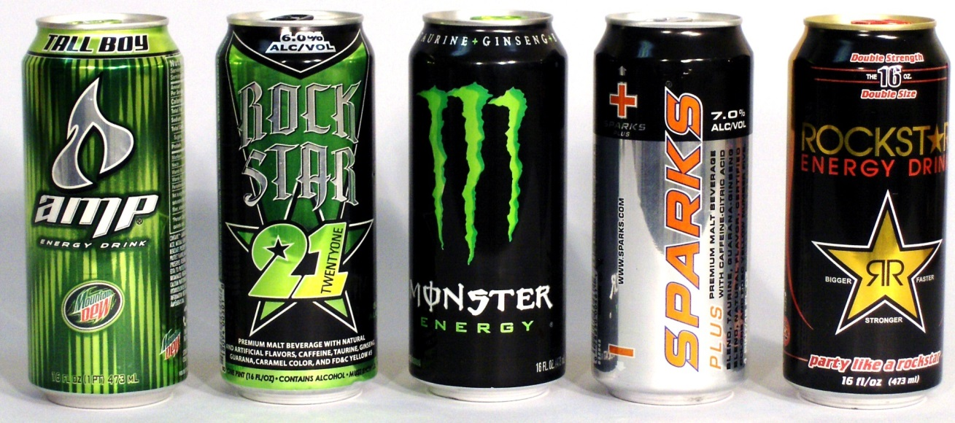
Product: Alcopops

Slide 31
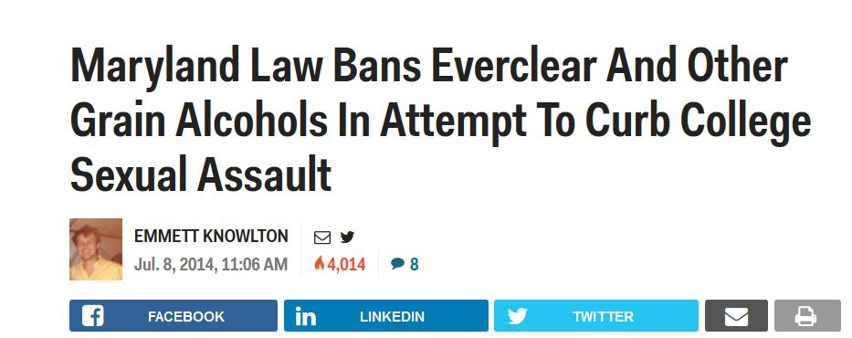
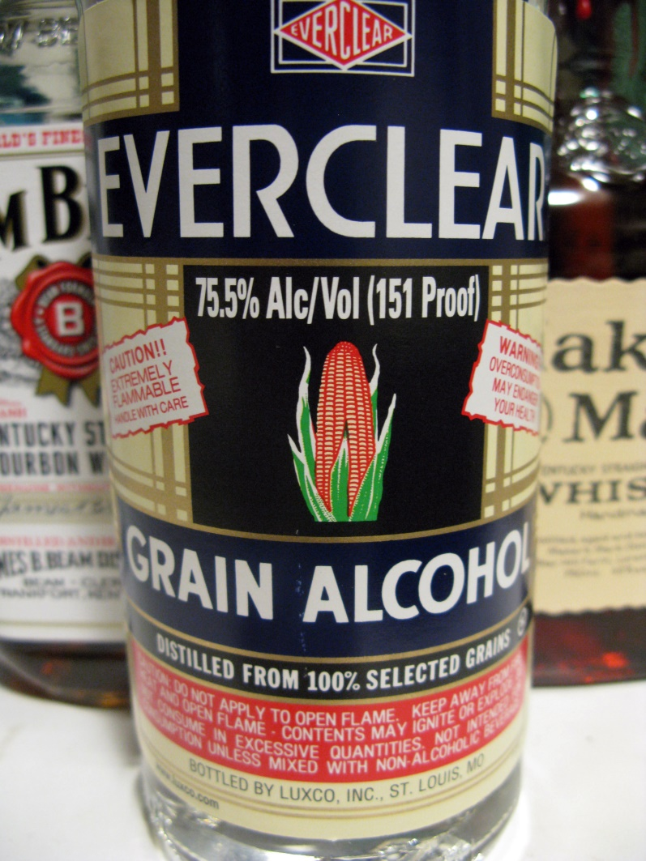
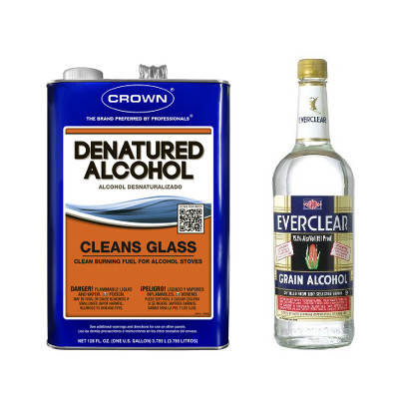
Product: Everclear

Slide 32
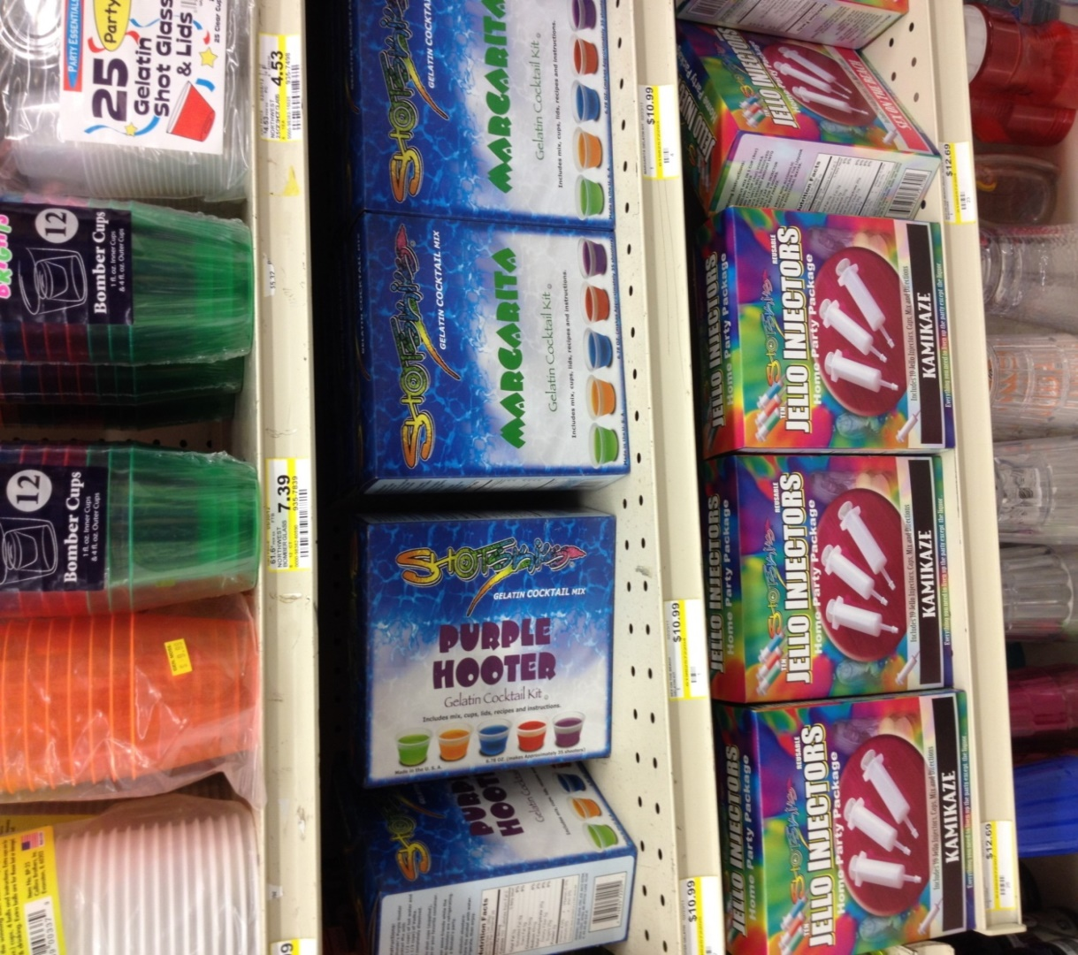
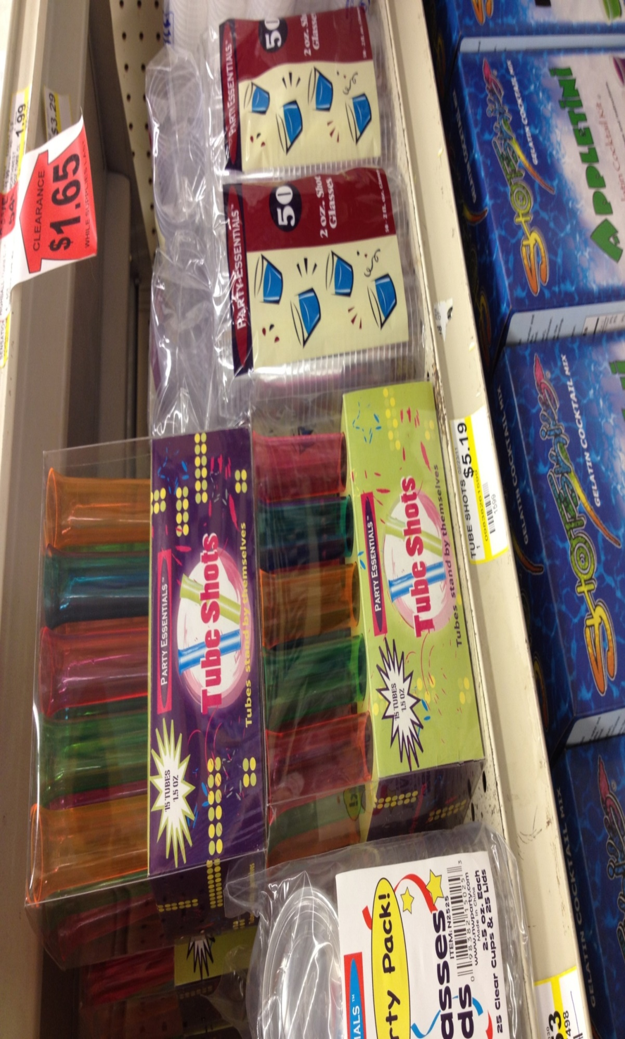
New Products

Slide 33

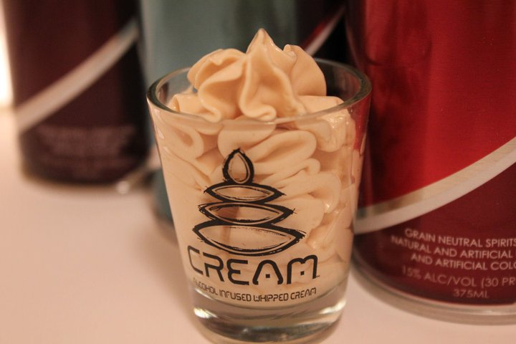
New Products

Slide 34
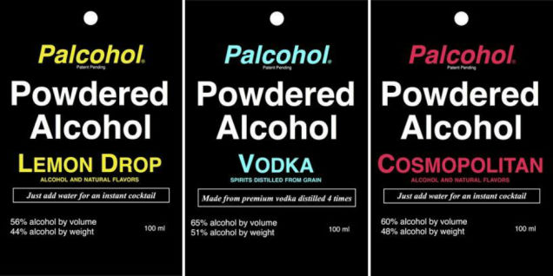
New Products

Slide 35
PROMOTION

Slide 36

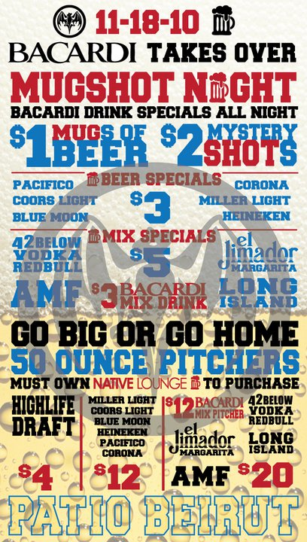

Slide 37
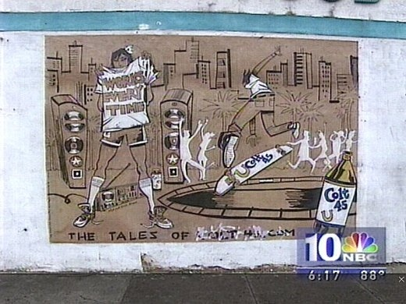
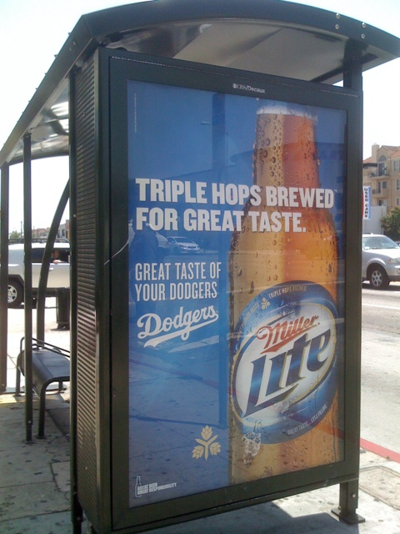
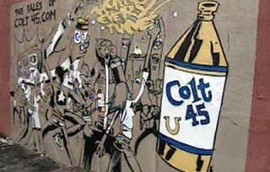
Outdoor Advertising

Slide 38
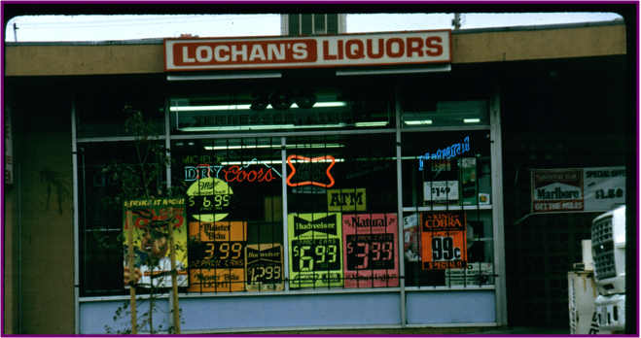
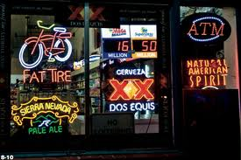
Alcohol Outlet Advertising

Slide 39
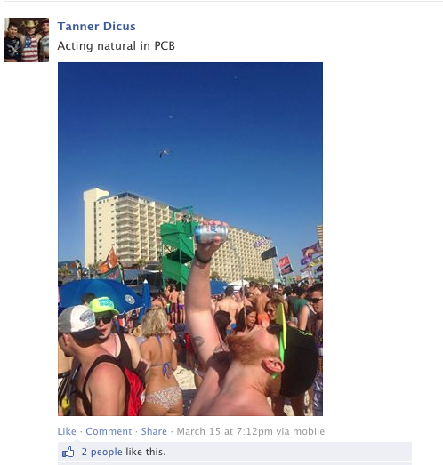
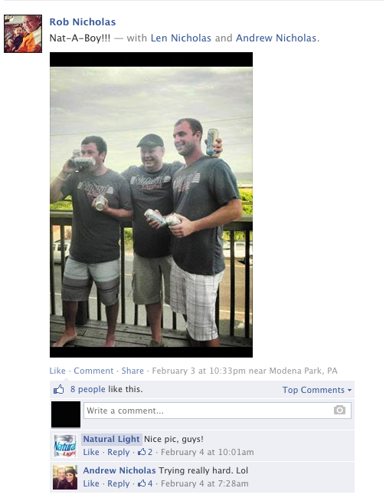
Fan-Uploaded Photo

Slide 40
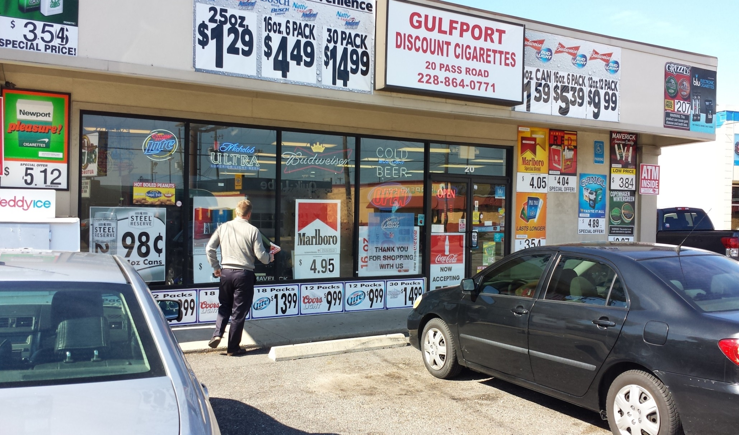
Outlet Exteriors

Slide 41
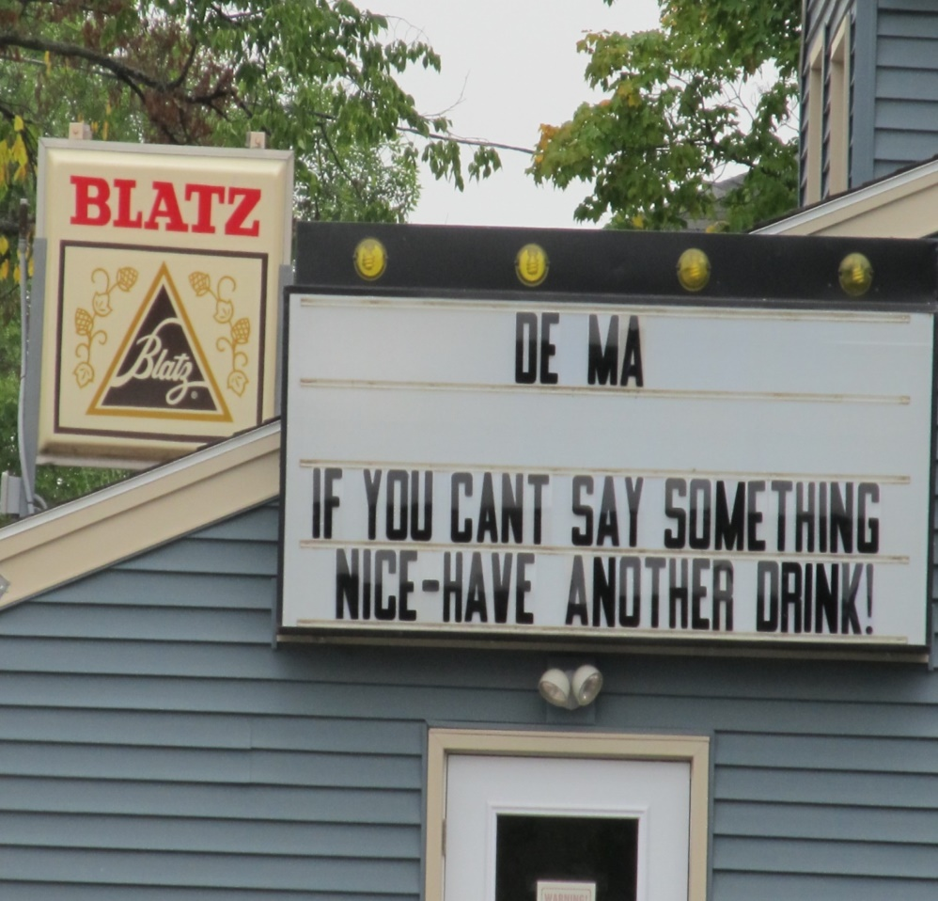
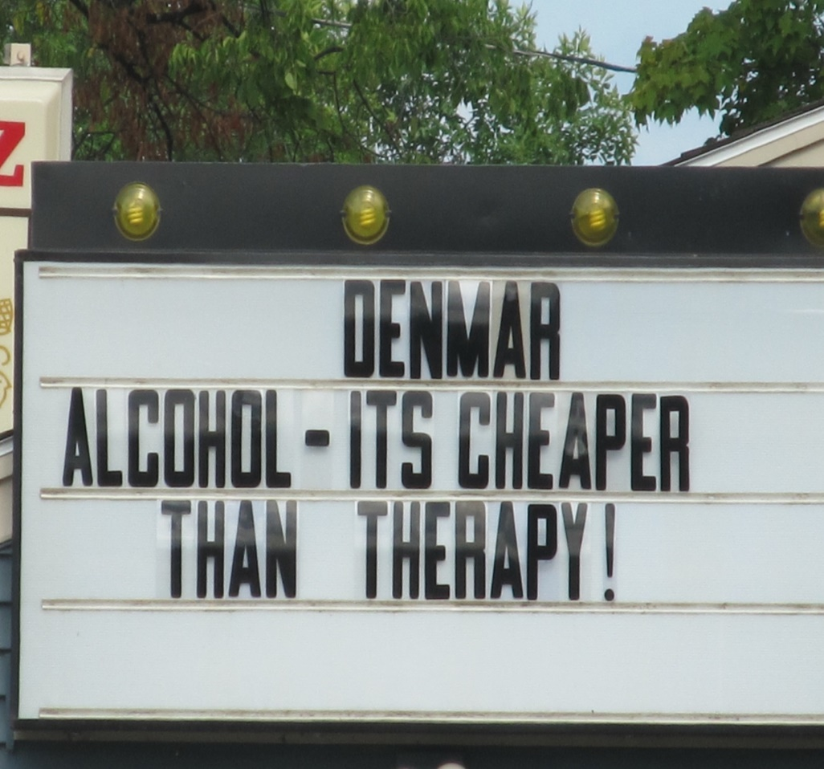
Outlet Exteriors

Slide 42
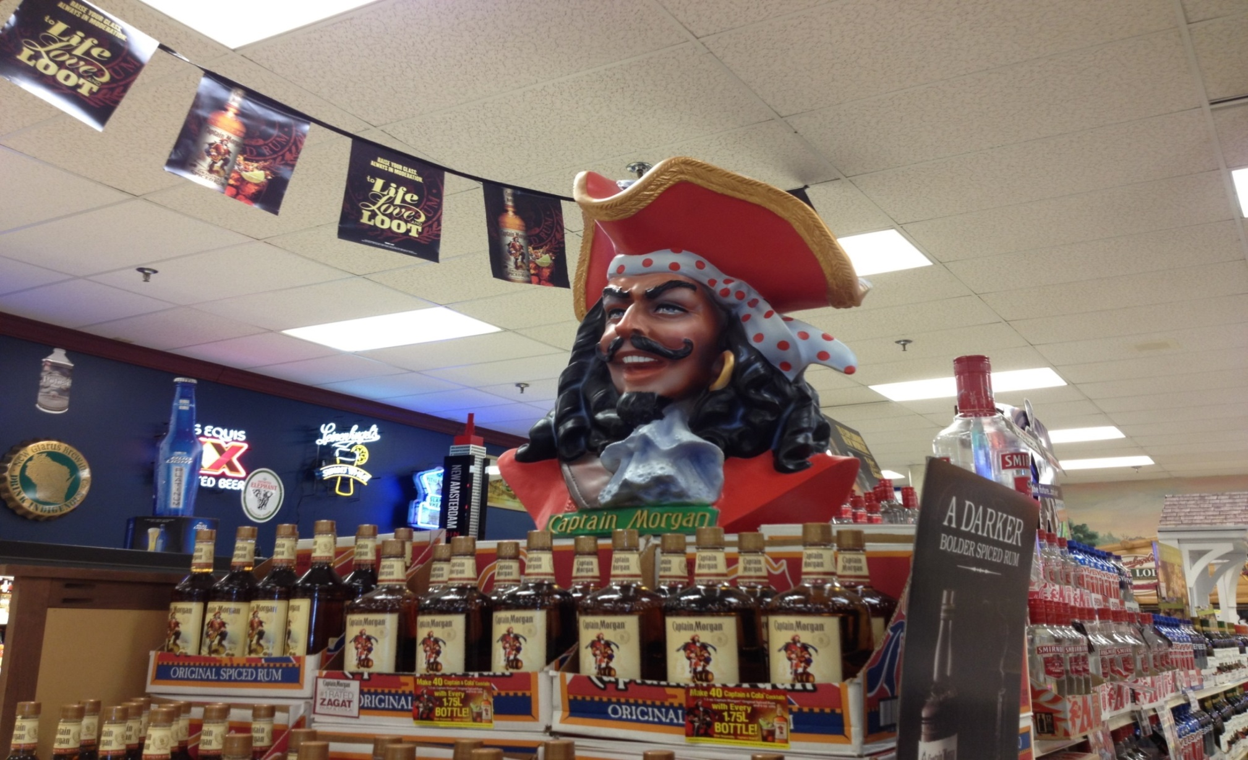
Outlet Interiors

Slide 43
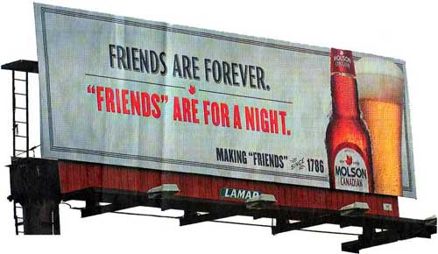
Billboards

Slide 44
PRICE
Notes:
The third “P”

Slide 45
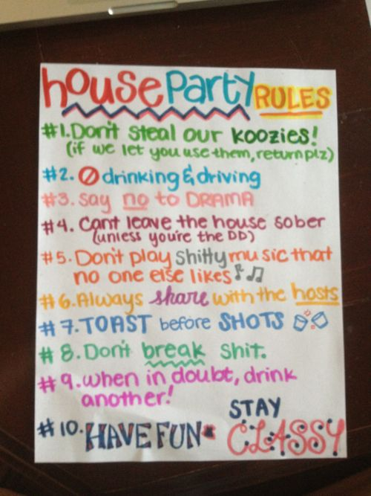
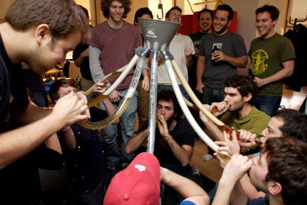
Cheap/Free Drinks – House Parties

Slide 46
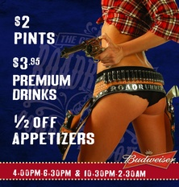
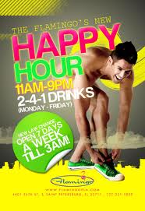
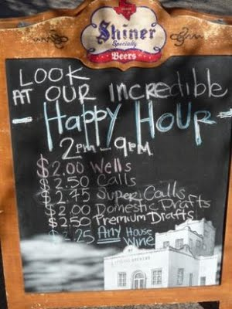
Cheap Drinks – Happy Hour

Slide 47
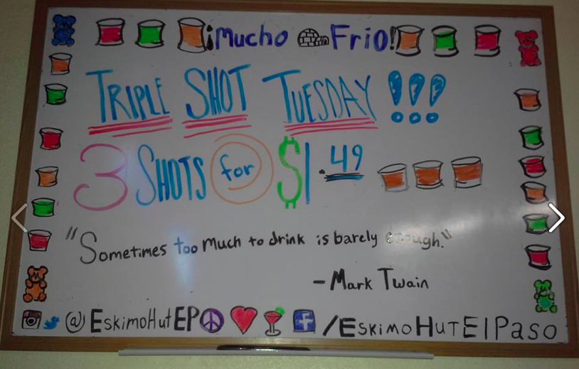
Cheap Drinks – Happy Hour

Slide 48
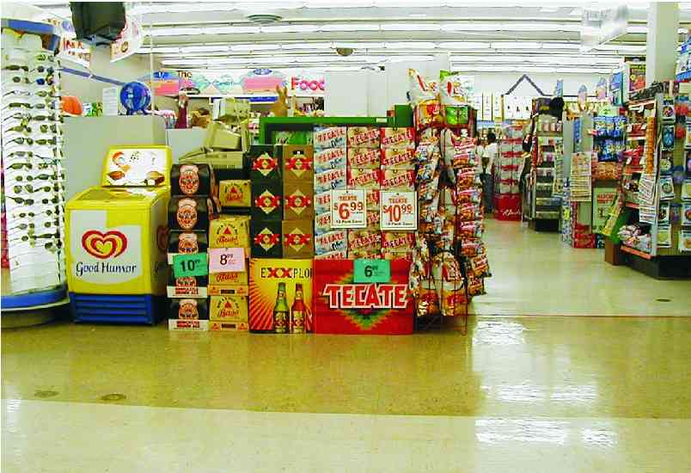
Cheap Alcohol –Drug Stores

Slide 49
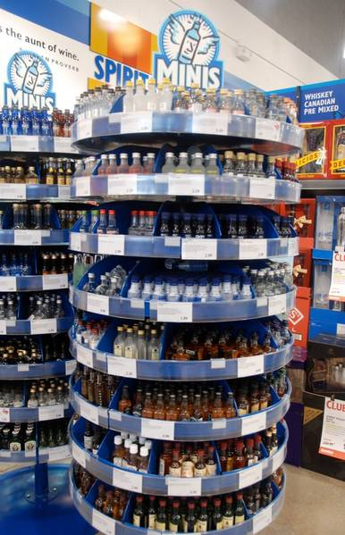
Small Bottles

Slide 50
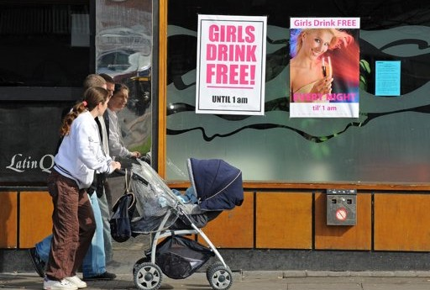
Price: Free Drinks

Slide 51
PLACE

Slide 52
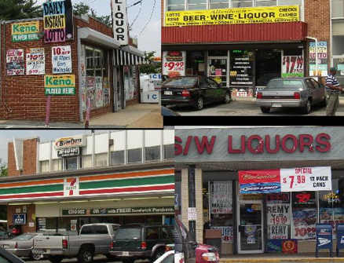
Number of Alcohol Outlets
Over concentration: A link to excessive consumption & violence

Slide 53
What the Science Says
Increased alcohol availability
Increased alcohol consumption
Increased public health/safety problems
Source: National Academy of Sciences

Slide 54
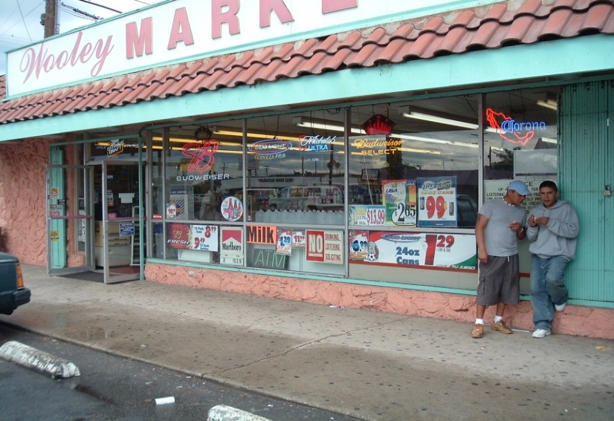
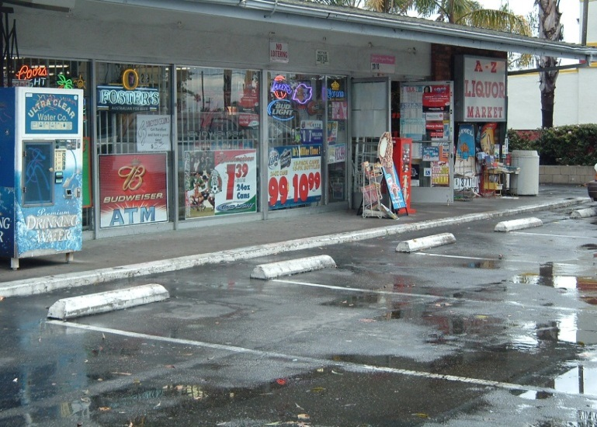
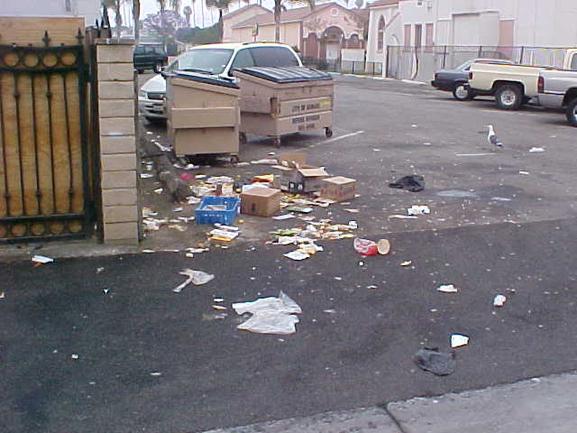


Problem Establishments

Slide 55




College Environments

Slide 56
Public Environments
Community Events
Public Spaces
  Beaches
  Parks
“No Man's Land”
  Parking Lots, Alleys

Slide 57
What Can We Do?
PRODUCT: alcohol impact areas, banning specific products
PRICE: alcohol tax increases, minimum unit pricing
PLACE: licensing/zoning reform
PROMOTION: local ad bans (billboards, public transit), retail signage restrictions and counteradvertising

Slide 58
How Can We Do It?
Keep track of changes in policy
  Newspaper
  ABC/ALE
  Industry newsletters/blogs
  NABCA, APIS, NCSL
  State Legislative websites: https://www.legis.ga.gov/
Know the science
  Price – taxes, minimum unit pricing, discounting
  Product – edibles, vapes, caffeinated alcoholic beverages
  Place – density, location, curbside pickup, delivery
  Promotion – marketing, social media

Slide 59
How Can We Do It?
Start conversations with your legislators early
  Educate
  Advocate
  Mobilize
  Organize

Slide 60
Make Environmental Change!
Get on our mailing list: email info@alcoholpolicy.org
Start your own statewide policy work: email me at dylan.cmjones@gmail.com
Get more training: dylan.cmjones@gmail.com
Register for our AP series conference, AP20 April 27-29, 2022: https://www.alcoholpolicyconference.org/

